Slide 1
A Siamese Network for generating oriented bounding box in object tracking
Yuchen Yang, Dong huo

Slide 2
Deep learning for tracking
Tracking task recap:

Slide 3
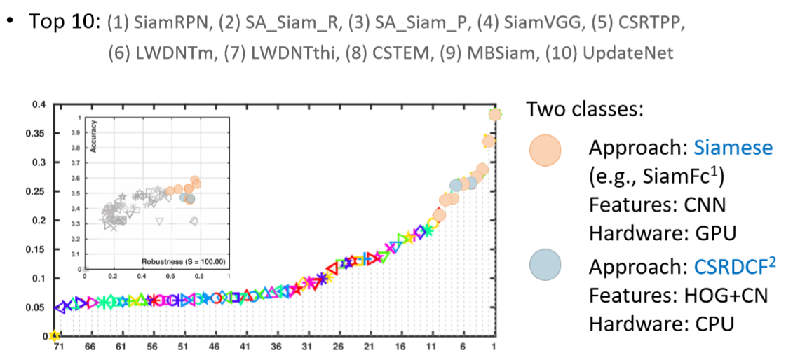
Siamese Network for tracking

Slide 4
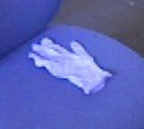
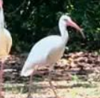
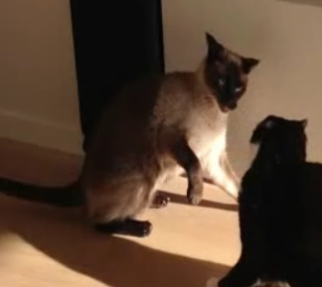
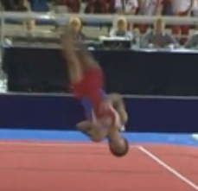
Towards better bounding box
VS
Axis–aligned bounding box
Orientated bounding box
Most deep learning methods can only generate axis-aligned bounding box in tracking. However, orientated bounding boxes describe the object better, it helps with reducing the background inside the bounding box.

Slide 5
Methodology
1. Overview warping pipeline
2. Siamese network structure
3. Three learning strategies

Slide 6
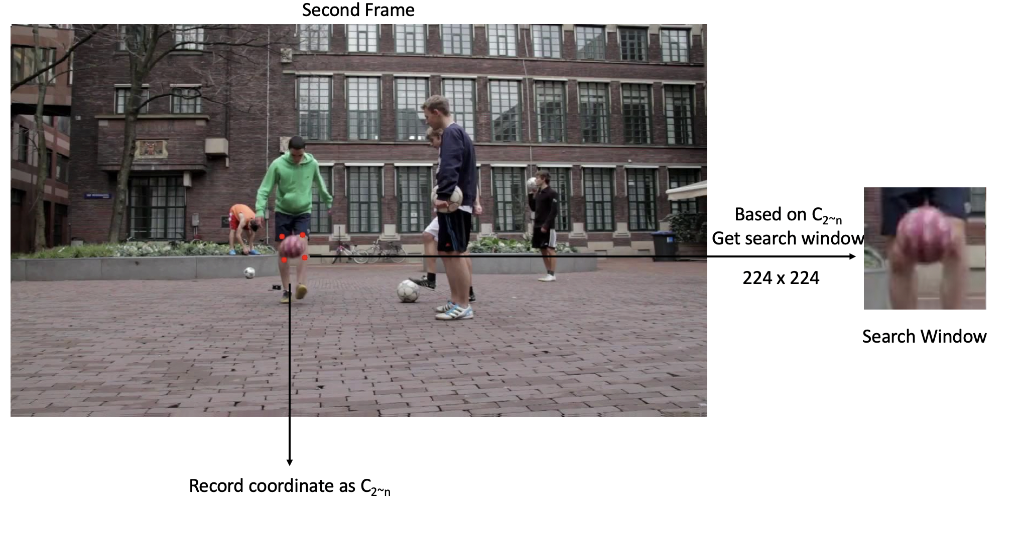
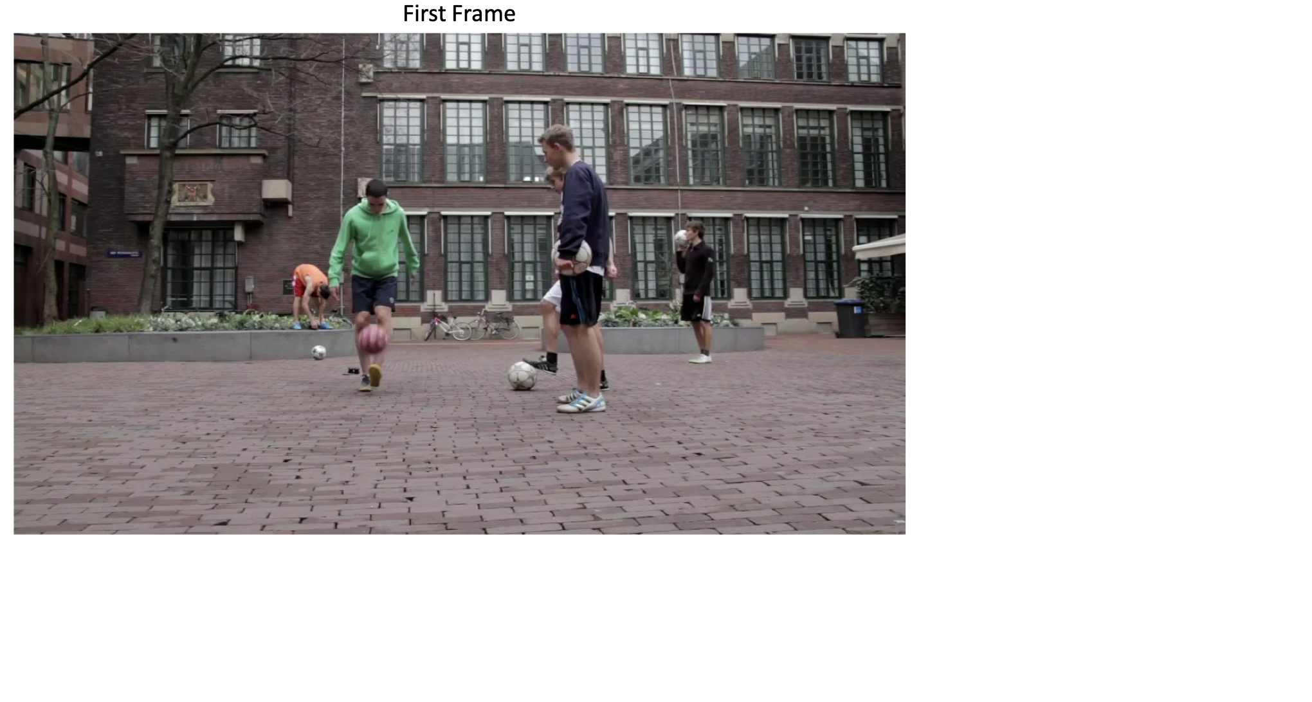
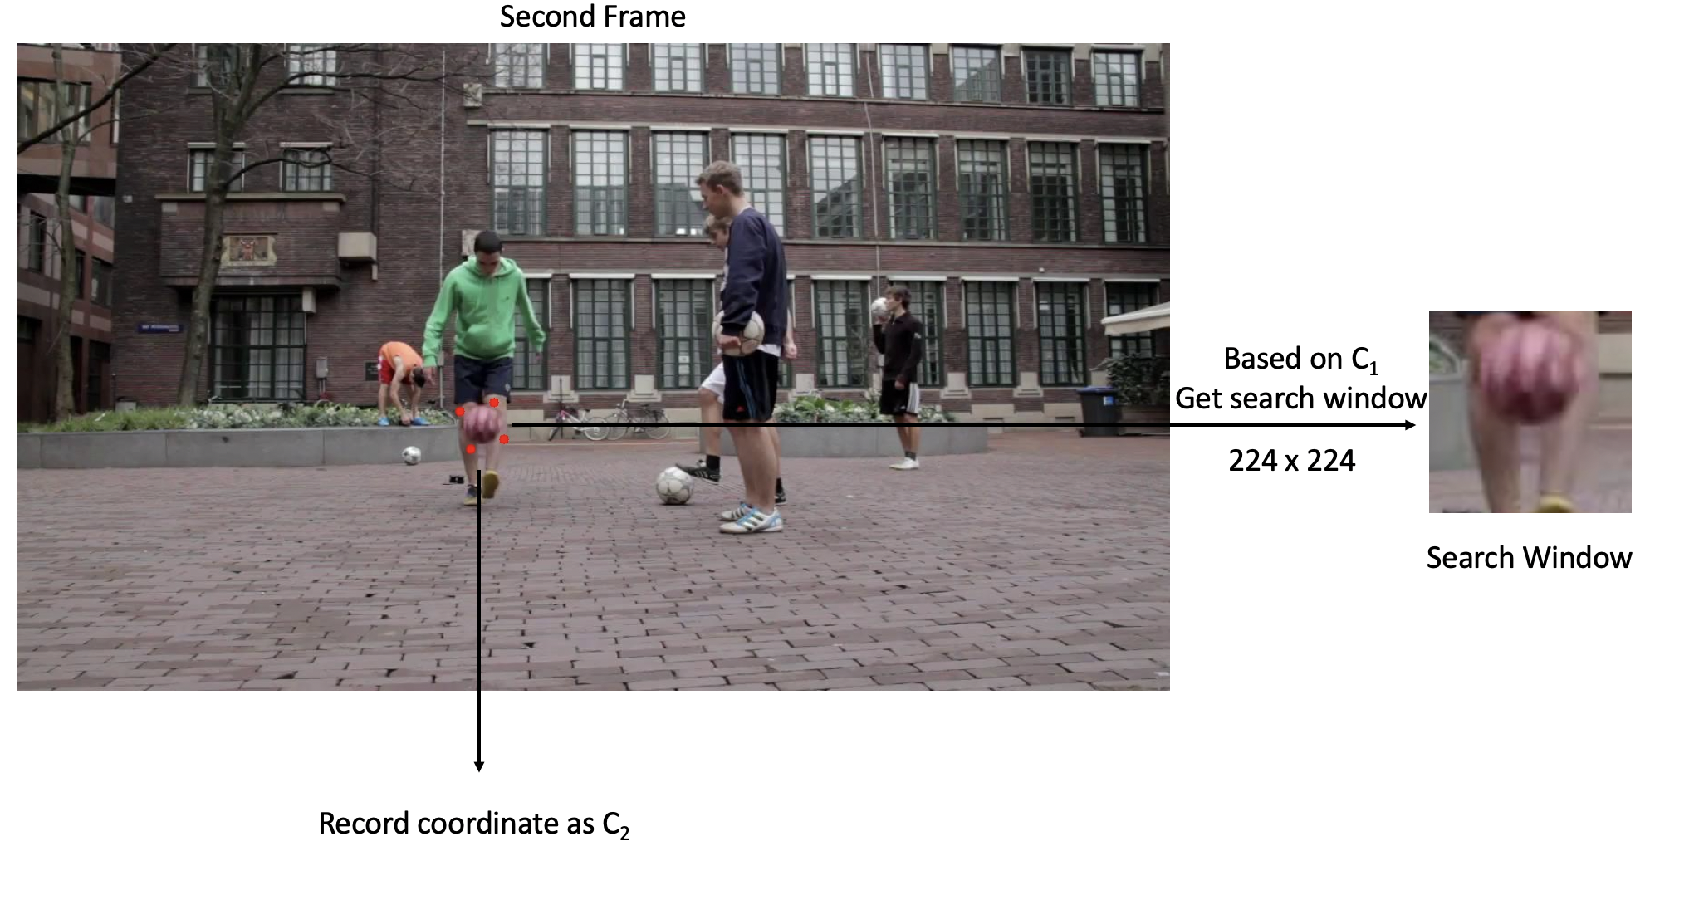
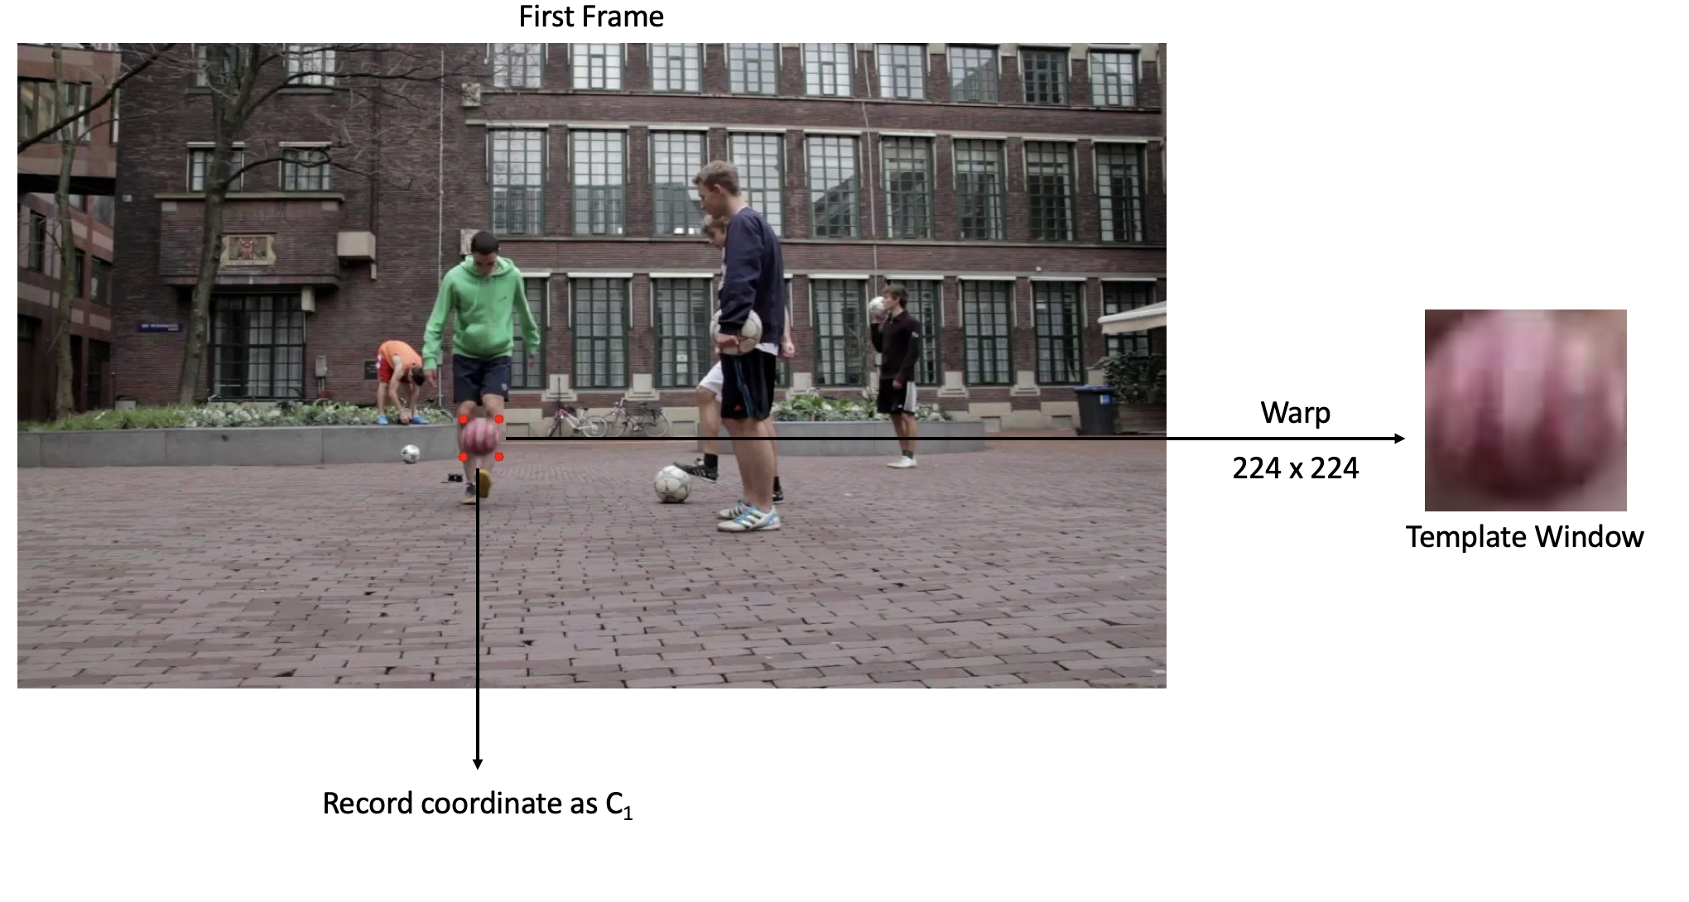
Overview warping pipeline
Training process

Slide 7


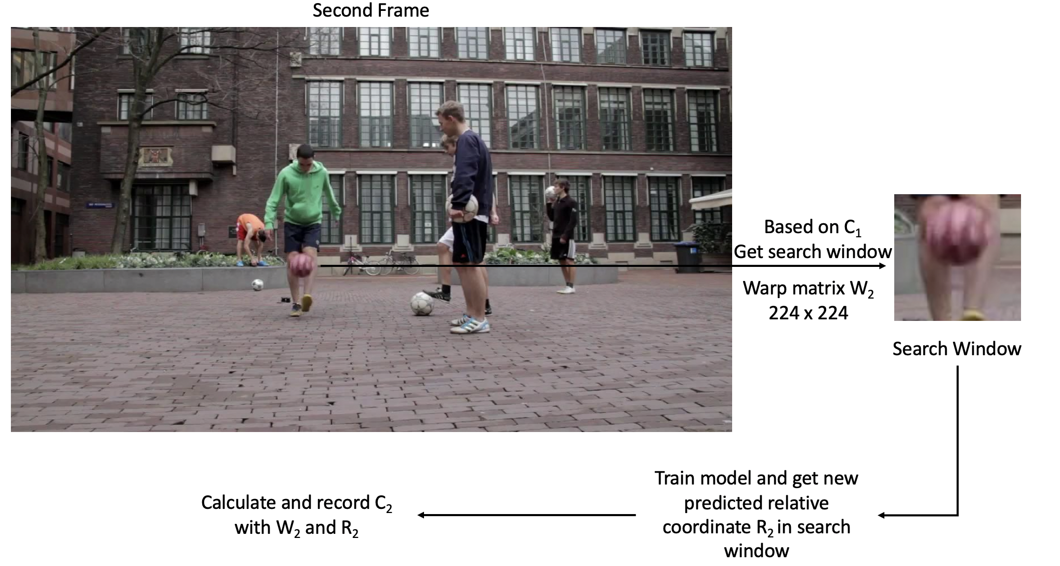
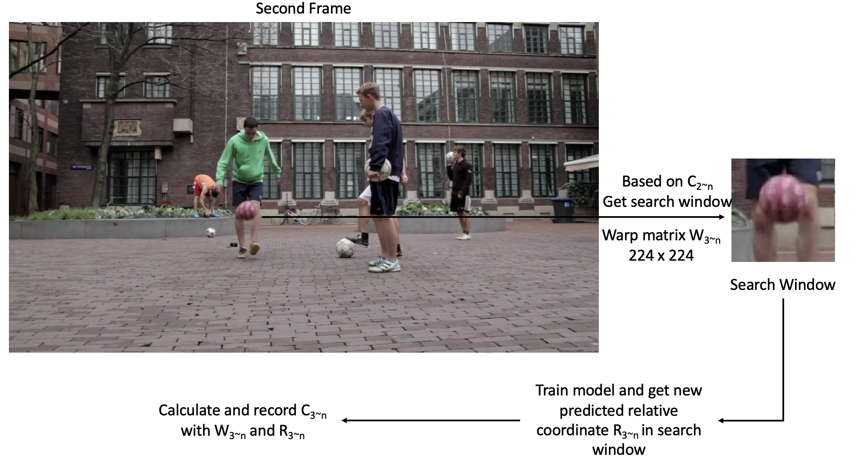
Overview warping pipeline
Testing process

Slide 8
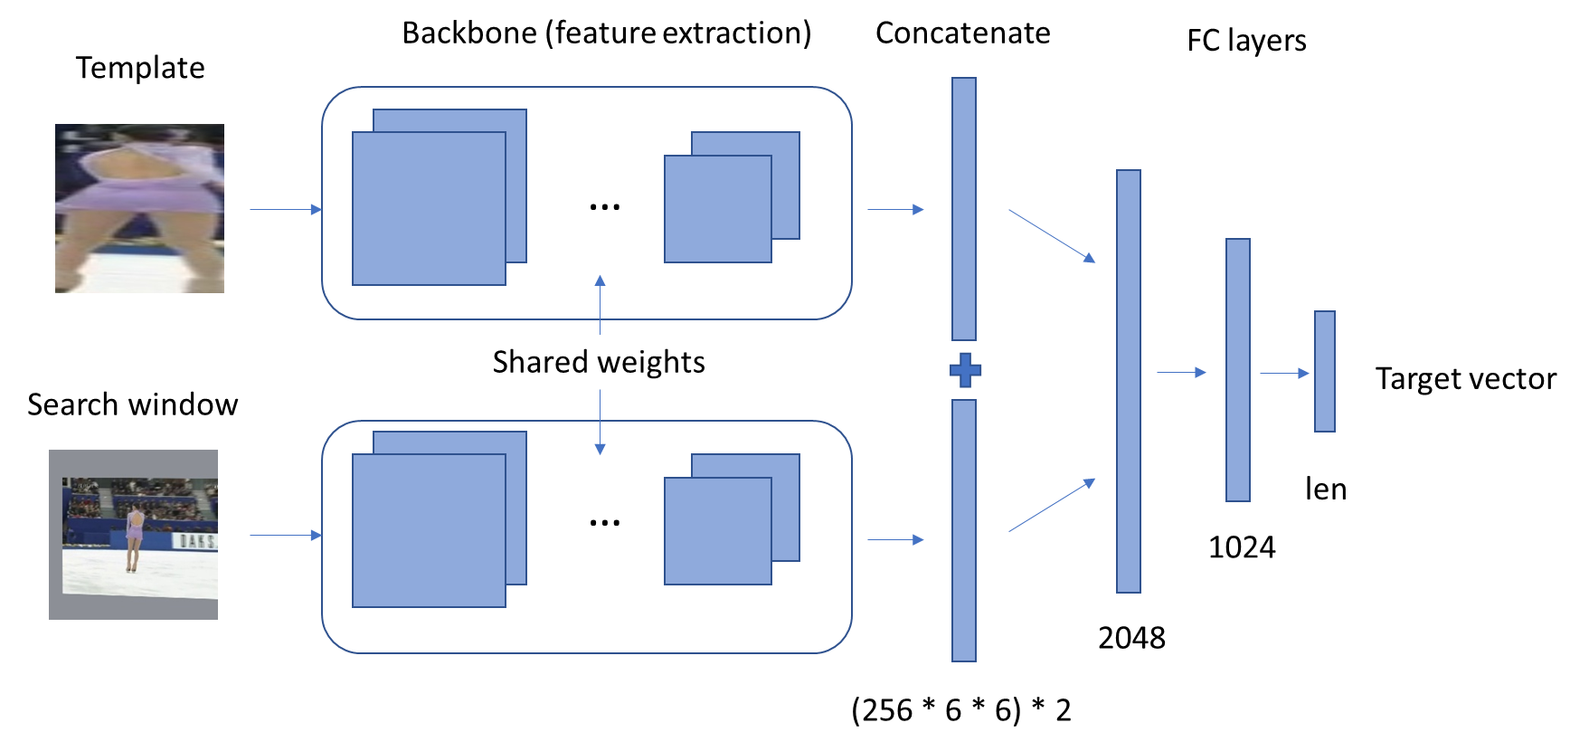
Siamese network structure
We choose the Alexnet as our backbone structure
Imagenet classification with deep convolutional neural networks

Slide 9

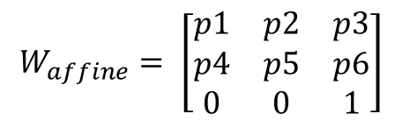
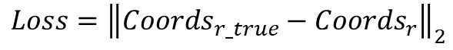
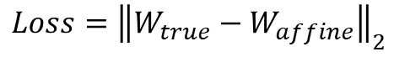
Three learning strategies
$$W_{affine}= \left[\begin{matrix}p1 & p2 & p3 \\ p4 & p5 & p6 \\ 0 & 0 & 1\end{matrix}\right]$$
$${Coords}_{r}=\{X1,Y1,X2,Y2,X3,Y3, X4,Y4\}$$
1. Borrow ideas from warp estimation using deep learning. Directly learn the warp parameters
2. Similar to object detection. Directly learn the relative coordinates
$$Loss={\left\|W_{true}−W_{affine}\right\|}_{2}$$
$$Loss={\left\|{Coords}_{r_true}−{Coords}_{r}\right\|}_{2}$$
Only p3 and p6 is well learned.
Overfitting significantly.

Slide 10
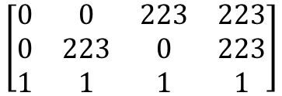
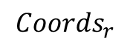

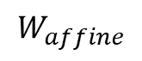
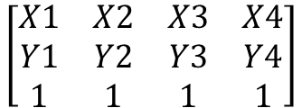


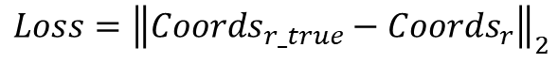
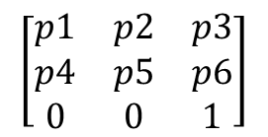
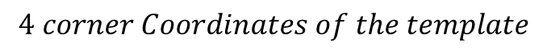
Three learning strategies
$$\left[\begin{matrix}p1 & p2 & p3 \\ p4 & p5 & p6 \\ 0 & 0 & 1\end{matrix}\right]$$
$$∗$$
$$\left[\begin{matrix}0 & 0 & 223 & 223 \\ 0 & 223 & 0 & 223 \\ 1 & 1 & 1 & 1\end{matrix}\right]$$
$$=$$
$$\left[\begin{matrix}X1 & X2 & X3 & X4 \\ Y1 & Y2 & Y3 & Y4 \\ 1 & 1 & 1 & 1\end{matrix}\right]$$
$$W_{affine}$$
$$4 corner Coordinates of the template$$
$${Coords}_{r}$$
3. Indirectly learn the warp by regressing on the relative coordinates after the warp.
$$Loss={\left\|{Coords}_{r_true}−{Coords}_{r}\right\|}_{2}$$
$${Coords}_{r}=W_{affine} ∗meshgrid(0,223)$$

Slide 11
Experiments
1. We use EAO (expected average overlap) to measure the performance of our tracker.
2. The tracker is tested on its training set (VOT 2016) and the testing set (18 videos from VOT 2014 that is not included in VOT 2016)
Unfortunately, we cannot compare with other methods fairly, the reasons are:
All the other Siamese network-based approaches are trained on larger datasets. We don’t have the time and resource to train on these datasets. It requires rearranging other datasets and a powerful GPU work station.
The VOT 2016 is the dataset we can find in MTF library that fits for training our model (in terms of variety of the categories and large number of frames).
http://webdocs.cs.ualberta.ca/~vis/mtf/

Slide 12
Experiments
 | VOT 2016
SiamFC-A [3] | 0.235
Color KCF [4] | 0.226
SO-DLT [5] | 0.221
KCF 2014 [6] | 0.192
Train set (VOT 2016) | Test set (subset of VOT 2014)
0.7327 | 0.223
Table 1. The EAO of our trained model tested on VOT 2016 (train set) and subset of VOT 2014 (test set).
Table 2. The EAO of other methods tested on VOT 2016 [2].

Slide 13
Experiments
Speed on Intel core i7, GTX 980m laptop
 | Speed
Template/ Search window loading | 0.004 s
Siamese network | 0.005 s
Transform to absolute coordinates | 0.0004 s
Overall can reach: more than 100fps on a laptop.

Slide 14
Demo
See the real time performances on Intel core i7, GTX 980m laptop.
1. Performance on training set (VOT 2016):
(1) Positive sequences: {gymnastics1, birds1, bag, girl}
(2) Negative sequences: {car1, fish1, nature}
2. Performance on testing set (subset of VOT 2014):
(1) Positive sequences: {ball, bicycle, surfing}
(2) Negative sequences: {trellis, torus}

Slide 15
Conclusion
1. In this research, we explore the possibility of using the Siamese network to generate orientated bound boxes that better describe the object.
2. We develop a learning strategy that indirectly learns the warp parameters and achieved a competitive result against advanced algorithms . (Though the comparison is not exactly fair)

Slide 16
Conclusion
Several problems we observed:
(1) Dataset with variety of objects and long sequence of labelled frames are needed.
(2) The generalization ability is not great. The template imposes less influence to the tracking result.
More can be done in the future:
(1) Enhance the template influence by introducing negative pairs.
(2) Integrate this methodology with SiamFC. (Concatenation -> cross correlation).

Slide 17
Reference
1. VOT datasets http://webdocs.cs.ualberta.ca/~vis/mtf/
2. The Visual Object Tracking VOT2016 challenge results
3. Fully-convolutional siamese networks for object tracking
4. Real-time ensemble-based tracker with kalman filter
5. Transferring rich feature hierarchies for robust visual tracking
6. High-Speed Tracking with Kernelized Correlation Filters

